Slide 1


Slide 8
Type | Num Filters / Neurons | Filter / Pool Size | Stride | Activation Function | Dropout
Convolutional | 64 | 8 | 1 | ReLU | -
MaxPooling | - | 8 | 8 | - | -
Convolutional | 32 | 8 | 1 | ReLU | -
Convolutional | 32 | 16 | 1 | ReLU | -
MaxPooling | - | 6 | 6 | - | -
Convolutional | 16 | 16 | 1 | ReLU | -
Convolutional | 16 | 32 | 1 | ReLU | -
MaxPooling | - | 4 | 4 | - | -
Convolutional | 16 | 32 | 1 | ReLU | -
Dense | 64 | - | - | ReLU | 0.5
Dense | 64 | - | - | ReLU | 0.5
Dense | 2 | - | - | SoftMax | -
Input timeseries
Type | Num Filters / Neurons / Heads | Filter / Pool / Head Size | Stride | Activation Function | Dropout
Convolutional | 64 | 8 | 1 | ReLU | -
MaxPooling | - | 8 | 8 | - | -
Convolutional | 32 | 8 | 1 | ReLU | -
Convolutional | 32 | 16 | 1 | ReLU | -
MaxPooling | - | 6 | 6 | - | -
Convolutional | 16 | 16 | 1 | ReLU | -
Convolutional | 16 | 32 | 1 | ReLU | -
MaxPooling | - | 4 | 4 | - | -
Convolutional | 128 | 1 | 1 | ReLU | -
Positional Encoding | - | - | - | - | -
Input timeseries
Multi-Attention Head | 8 | 16 | - | ReLU | 0.0
Dense | 64 | - | - | ReLU | 0.1
Dense | 2 | - | - | ReLU | 0.1
Binary Classification
Dense | 500 | - | - | ReLU | 0.1
Dense | 2 | - | - | SoftMax | -
Input timeseries
Binary Classification
Type | Num Filters / Neurons / Heads | Filter / Pool / Head Size | Stride | Activation Function | Dropout
Convolutional | 128 | 1 | 1 | ReLU | -
Positional Encoding | - | - | - | - | -
Multi-Attention Head | 8 | 16 | - | ReLU | -
Dense | 64 | - | - | ReLU | 0.1
Dense | 2 | - | - | ReLU | 0.1
×8
Attention Blocks
Dense | 64 | - | - | ReLU | 0.1
Dense | 2 | - | - | SoftMax | -
Binary Classification

Slide 9
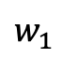
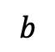
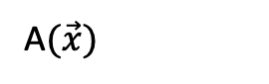
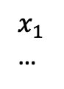
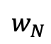
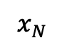
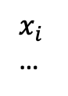
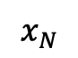
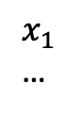
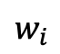
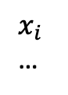
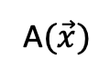
Artificial Intelligence
Artificial Neural Networks
Deep Learning
Machine Learning
$x_{1}$
…
$$w_{1}$$
$x_{i}$
…
$$w_{i}$$
$$b$$
σ
A$(\vec{x})$
$x_{N}$
$$w_{N}$$
$x_{1}$
…
$x_{i}$
…
A$(\vec{x})$
$x_{N}$

Slide 10
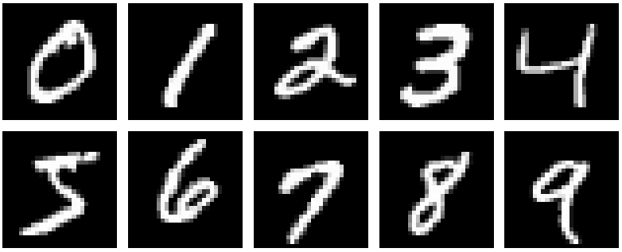
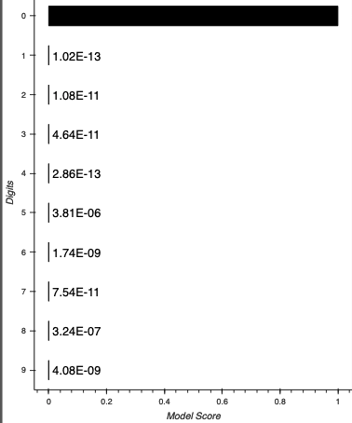
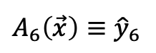
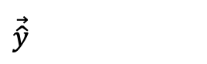
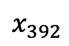
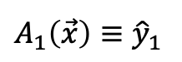
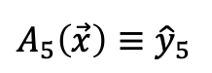
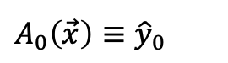
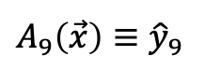
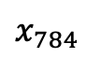
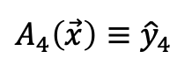
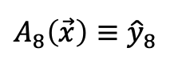
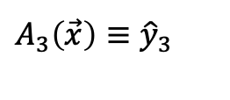
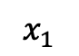
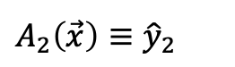
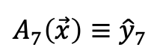
Artificial Intelligence
Artificial Neural Networks
Deep Learning
Machine Learning
…
$x_{1}$
$$A_{0}\left(\vec{x}\right)≡{\hat{y}}_{0}$$
$$A_{1}\left(\vec{x}\right)≡{\hat{y}}_{1}$$
$$A_{2}\left(\vec{x}\right)≡{\hat{y}}_{2}$$
$$A_{3}\left(\vec{x}\right)≡{\hat{y}}_{3}$$
flatten
$$x_{392}$$
$$A_{4}\left(\vec{x}\right)≡{\hat{y}}_{4}$$
$$\vec{\hat{y}}$$
$$A_{5}\left(\vec{x}\right)≡{\hat{y}}_{5}$$
$$A_{6}\left(\vec{x}\right)≡{\hat{y}}_{6}$$
…
$$A_{7}\left(\vec{x}\right)≡{\hat{y}}_{7}$$
$$A_{8}\left(\vec{x}\right)≡{\hat{y}}_{8}$$
$$x_{784}$$
$$A_{9}\left(\vec{x}\right)≡{\hat{y}}_{9}$$

